Slide 1
CSS IN A COMPONENT BASED WORLD

Slide 2

Hello!
I AM ALICE BROSEY
@ambroseya
alice@alicebrosey.com
<number>
Notes:
1

Slide 3
?
Hypothetical example
Why are we talking about this anyway?
<number>

Slide 4
Which is more important… ease of writing code or the ease of maintaining and extending the code?
<number>

Slide 5
SASS & LESS
More sophisticated syntax
Mixins
Variables
Extends
Nesting
Logic
Separated Files
<number>

Slide 6
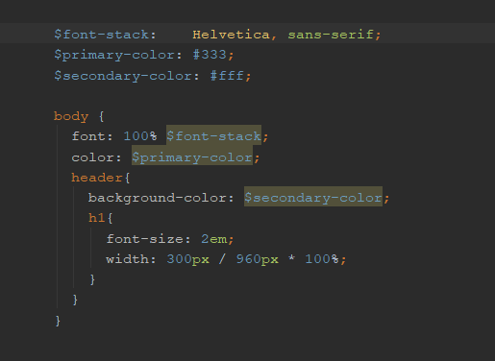
SASS Sample
<number>

Slide 7
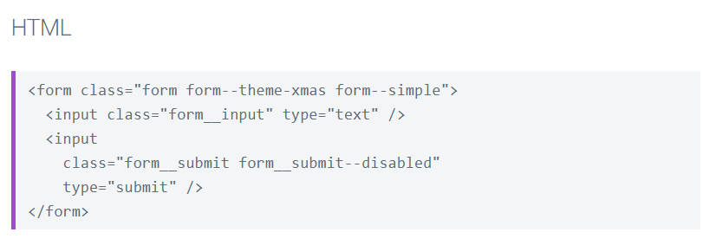
BEM – Block Element Modifier
Naming Convention, not a framework or plugin
<number>

Slide 8
TWO MAJOR METHODS
CSS in JS
Code inside components
CSS Modules
Modular CSS imported into components
<number>

Slide 9
CSS-in-JS
Separation of Concerns?
Or
Separation of Technologies?
<number>

Slide 10
THIS ISN’T A CSS-JS TALK IF I DON’T QUICKLY SUMMARIZE Christopher Chedeau’s talk from 2015
Problems with CSS At Scale
Global Namespace
Dependencies
Dead Code Elimination
Minification
Sharing Constants
Non-deterministic Resolution
Isolation
<number>

Slide 11
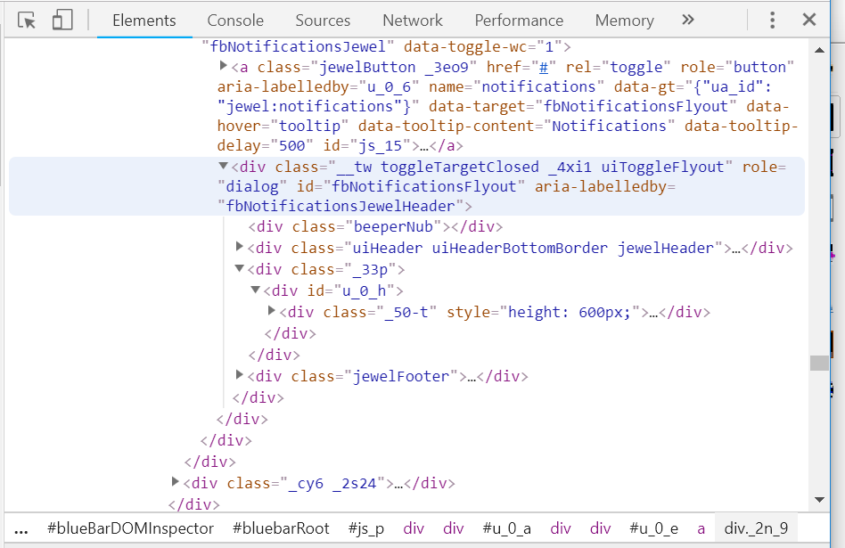
The Conclusion
Internal Compiler to create custom minified class names
Some directly inline styles
<number>

Slide 12
CSS – IN - JS
SIMILAR FRAMEWORKS
Radium
Aphrodite
styled-components
<number>

Slide 13
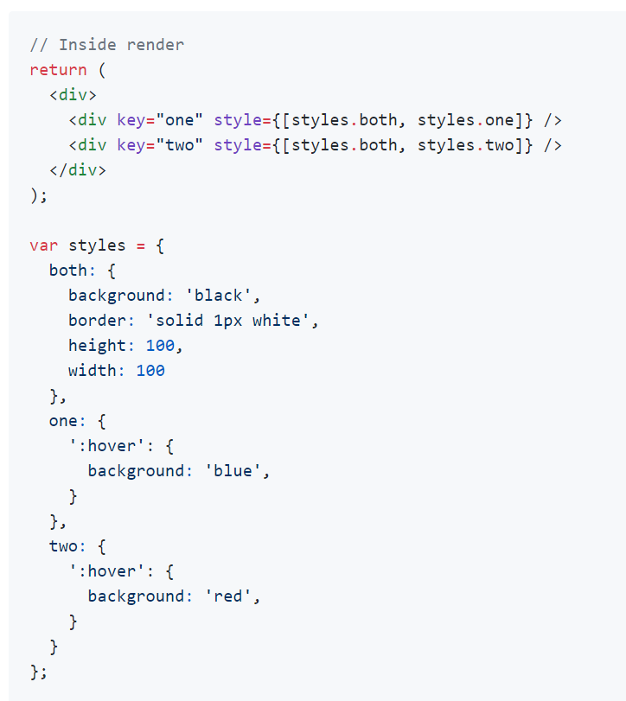
Radium Sample
<number>
Notes:
1

Slide 14
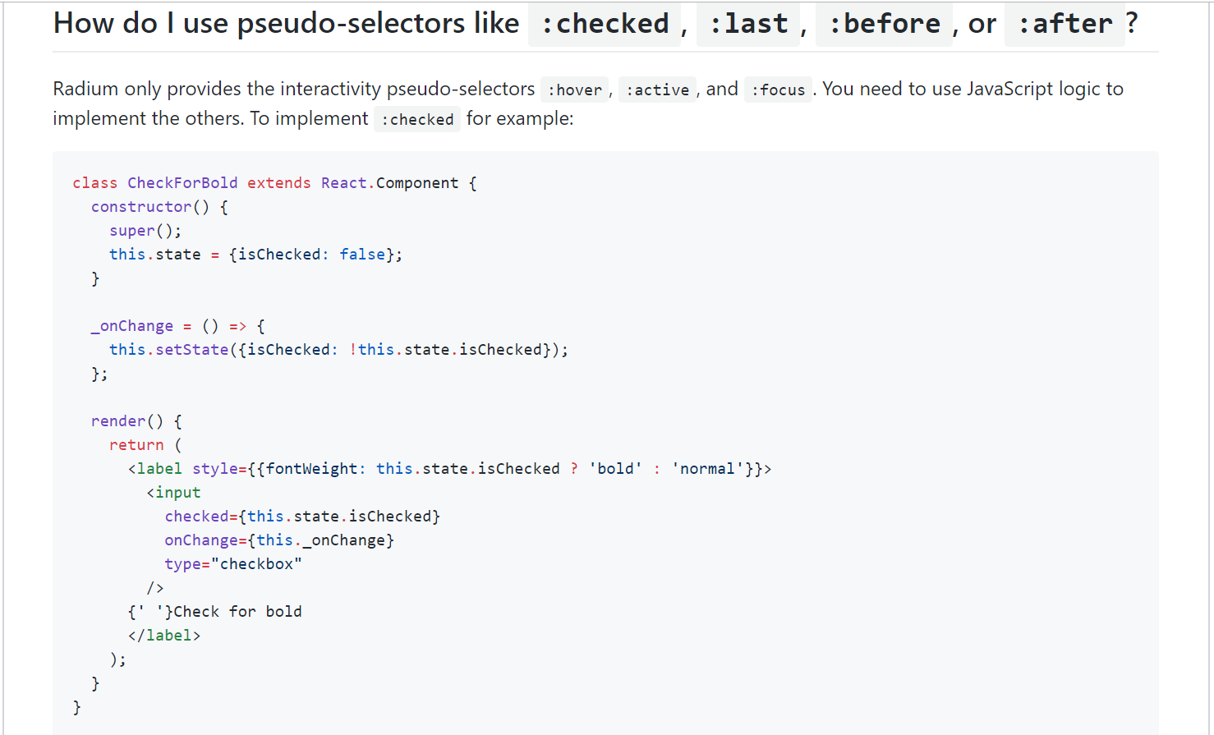
THIS ISN’T A CSS-JS TALK IF I DON’T QUICKLY SUMMARIZE Christopher Chedeau’s talk from 2015
<number>
Notes:
1

Slide 15
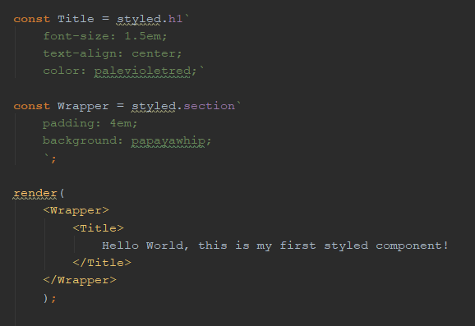
Styled-components Sample
<number>
Notes:
<number>

Slide 16
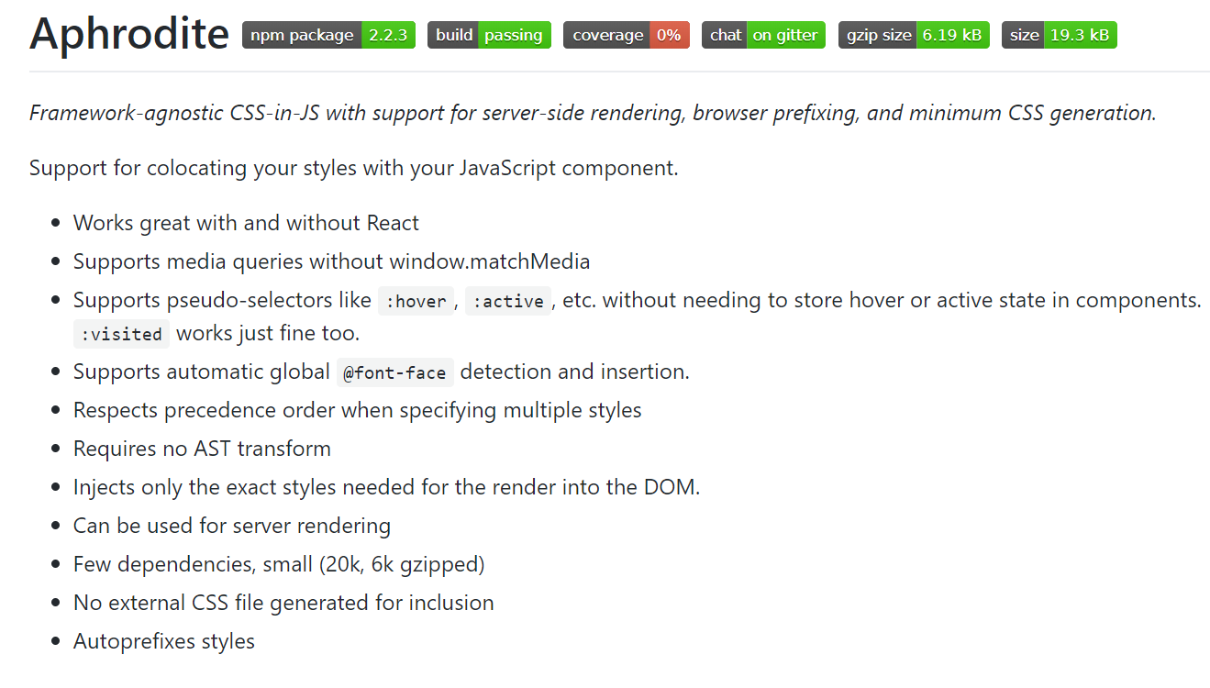
Aphrodite Docs Excerpt
<number>
Notes:
<number>

Slide 17
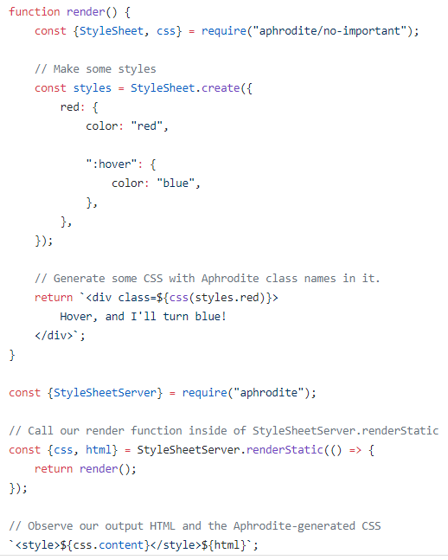
Aphrodite
<number>
Notes:
<number>

Slide 18
CSS – IN - JS
PROS
Unified source for reusable pieces
Scoped selectors
CONS
Styles use size increases with size of app
<number>

Slide 19
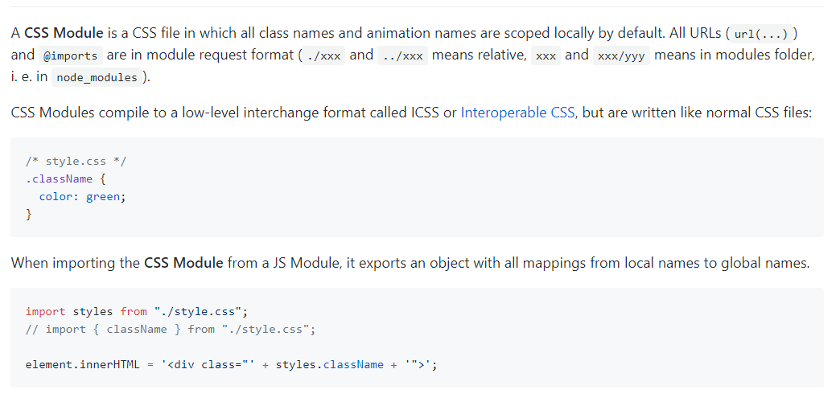
CSS Modules
<number>

Slide 20
GAMES?
CSS Games
https://codepen.io/collection/AKkZro/
(yes I am going to tweet that as soon as I’m done talking, if you want an easier to click link)
<number>
Notes:
<number>

Slide 21
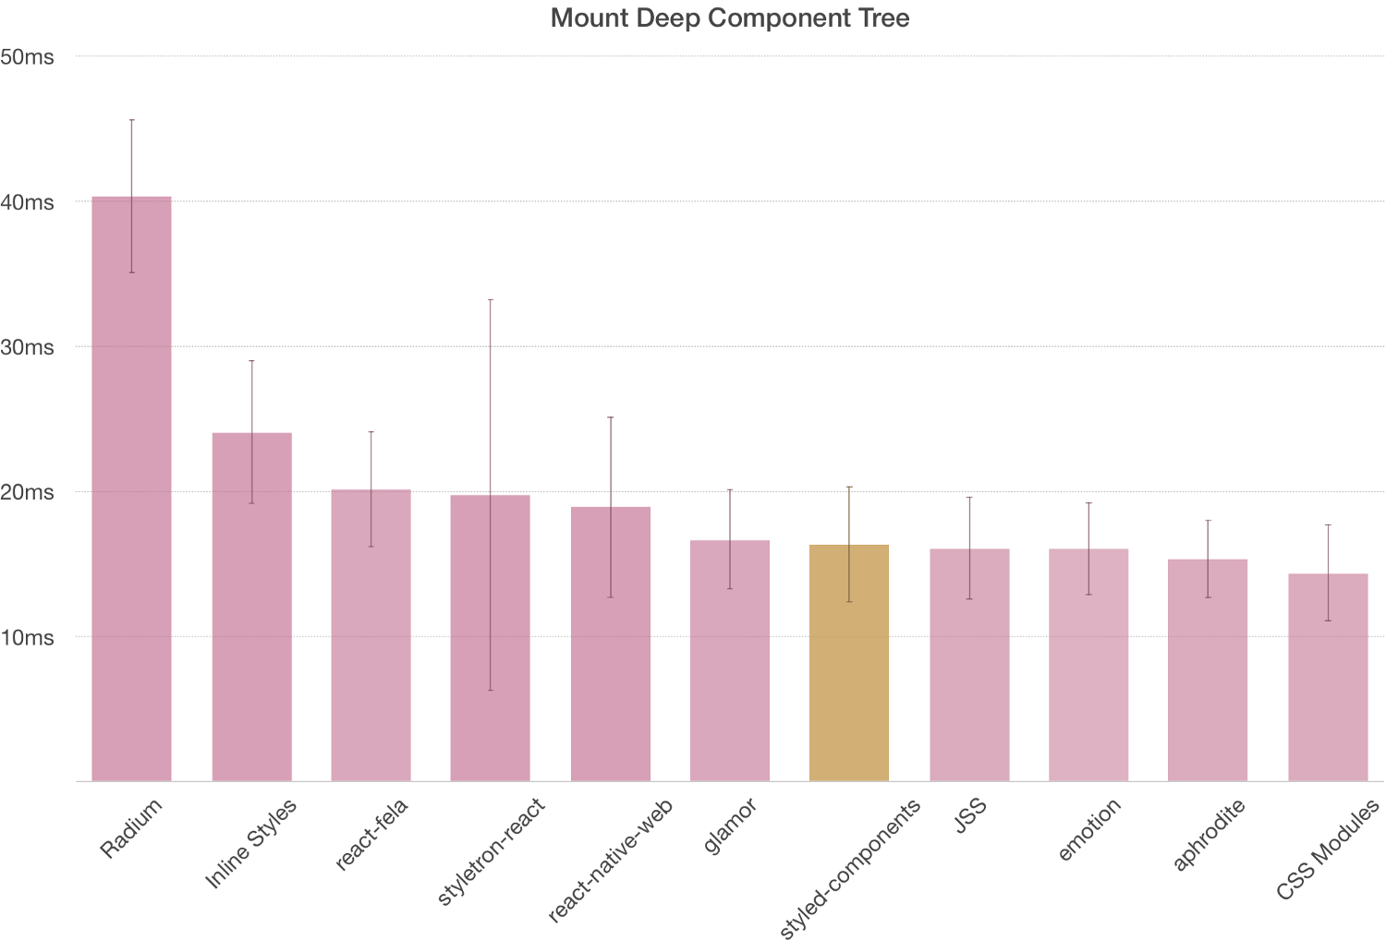
<number>
Notes:
<number>

Slide 22
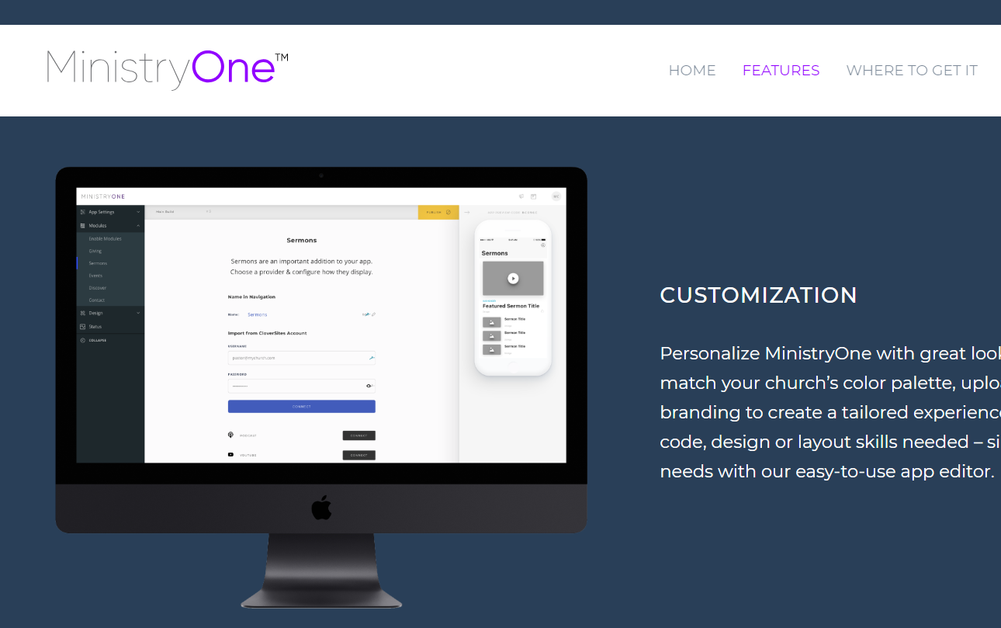
PERSONAL EXAMPLE
<number>
Notes:
<number>

Slide 23
TRY TO EMBRACE IT
Good CSS Architecture Saves Dev Time
A preventative measure for future headaches
Every project needs a proper approach
FOR THAT PROJECT
<number>
Notes:
<number>

Slide 24
Thanks!
ANY QUESTIONS?
You can find me at
@ambroseya
alice@alicebrosey.com
<number>
Notes:
<number>

